Slide 1
To Save a Heart
Henry Oluka, Paul Parkin, Ryan Woodward

Slide 2
Purpose
Analyzing trends in heart patients to determine whether patterns emerge to help diagnose heart disease and potentially reduce the number of fatal cardiac arrests.

Slide 3
Motivation
The data was selected for personal reasons due to a team member’s loss of a family member. This inspired research into new visualizations to assist physicians in preventing heart attacks.

Slide 4
Research Question
Can data visualizations reduce the technical expertise required in order to effectively diagnose whether or not an individual has heart disease?

Slide 5
Data
Cases: Patients
Dimensions: age, sex, chest pain type, resting blood pressure, serum cholesterol, fasting blood sugar, resting cardio graphic maximum heart rate achieved, exercise induced angina, old-peak, slope peak exercise, number of major vessels, and thal
303 cases X 13 dimensions
https://archive.ics.uci.edu/ml/datasets/Heart+Disease

Slide 6
Data Questions
Are there emerging patterns for patients who experience cardiac issues at a younger age?
Are there warning signs that a cardiac arrest is imminent given the pain described and the underlying symptoms?
Is there a threshold at which a patient needs invasive surgery, or can surgery be avoided?

Slide 7
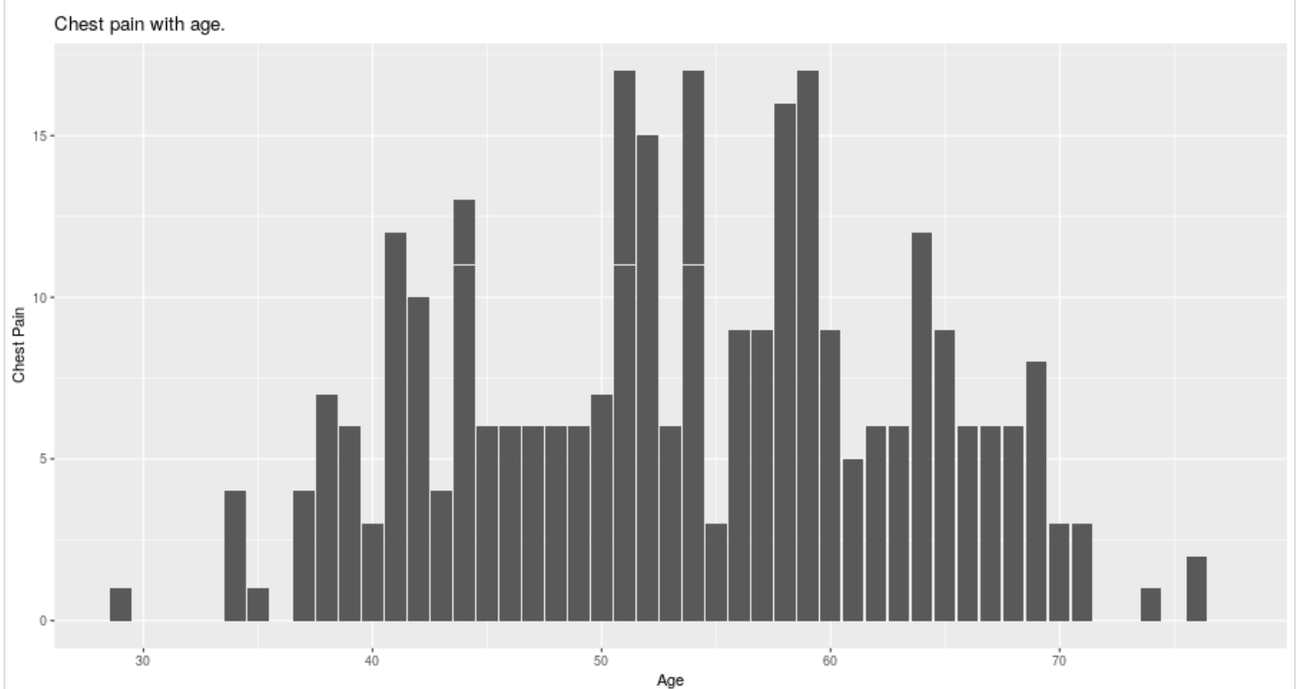
Related Work / Existing knowledge
Chest pain tends to peak between the ages of 50 and 60

Slide 8
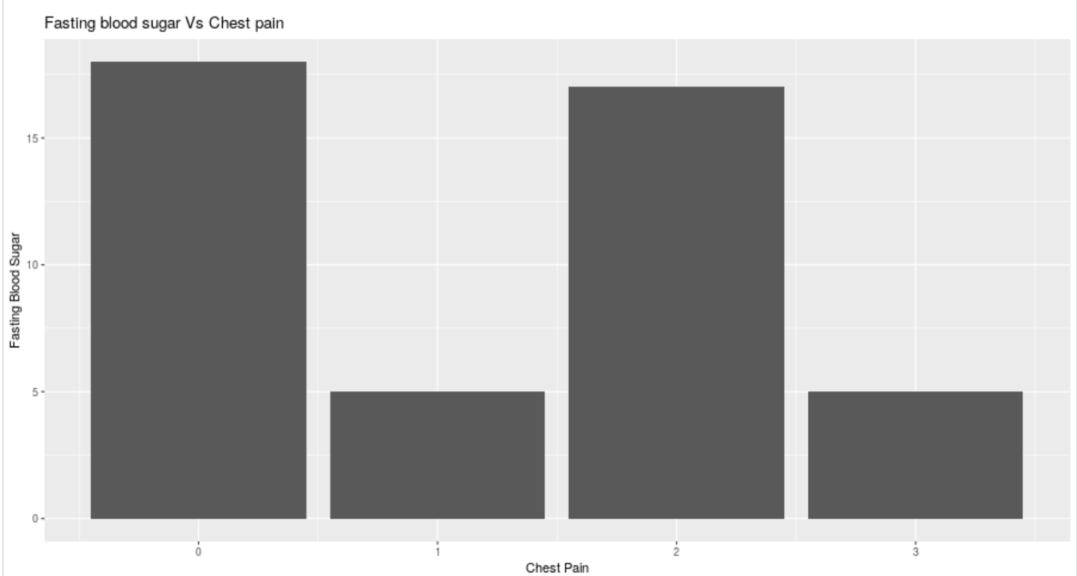
Related Work / Existing
knowledge
Fasting Blood Sugar has very little effect on patient’s pain report

Slide 9
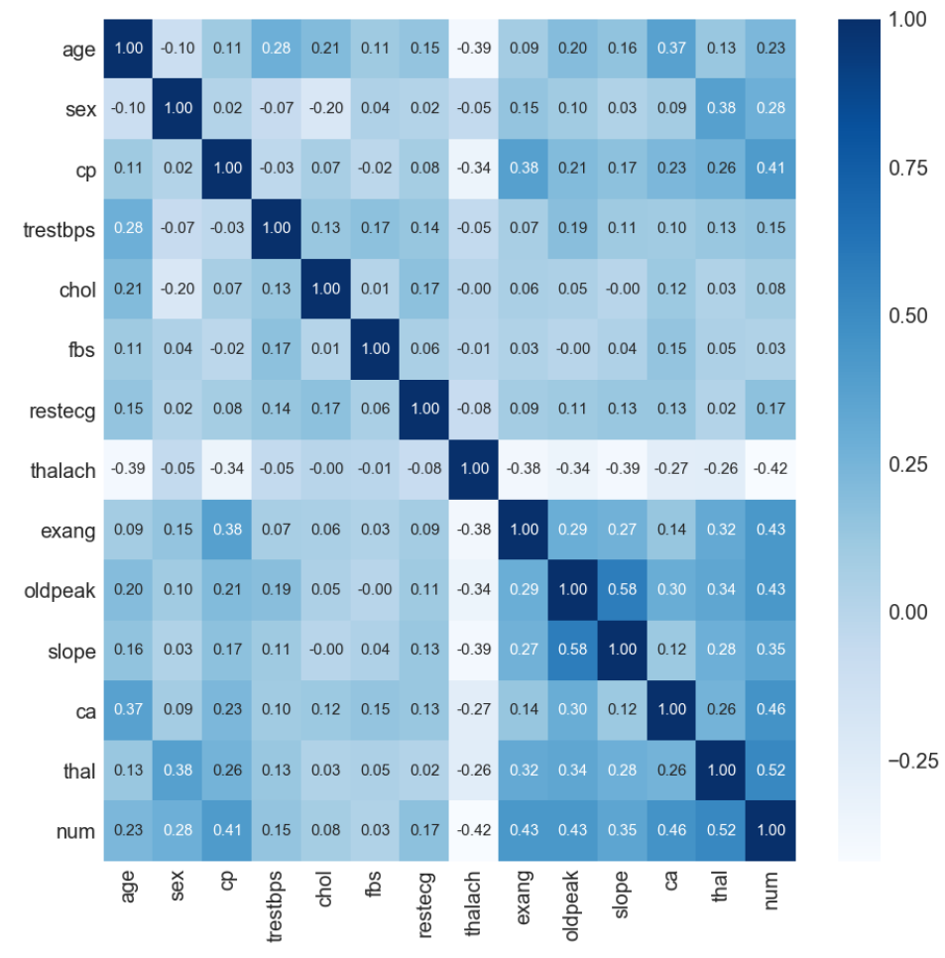
Related Work / Existing
knowledge
Data analysis in the form of a correlation matrix has been explored by Jae Duk Seo
https://towardsdatascience.com/basic-medical-data-exploration-visualization-heart-diseases-6ab12bc0a8b7

Slide 10
Related Work / Existing
knowledge
Strong correlations between
Heart Defects and predictable Heart Attacks
Exercise Induced Angina leading to Chest Pain and Heart Attacks

Slide 11
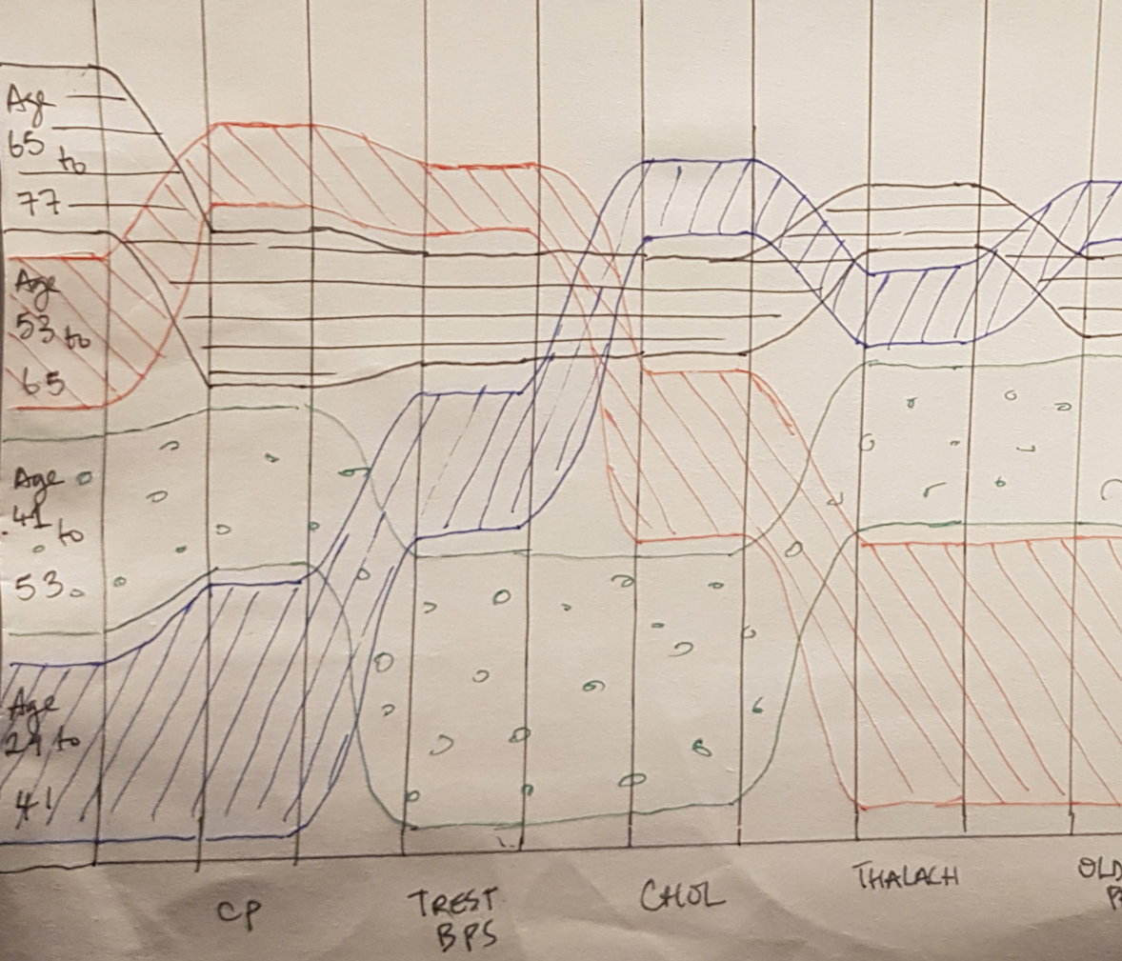
Initial Sketches
Visualizing emerging patterns for patients using:
Age category, and
The value of each heart disease attribute in the dataset varies w.r.t age category.
Features
The x-axis
Presence of heart disease indicators.
The y-axis
age-categories from the dataset.
Ribbons:
Ribbon Size: case frequency for given attribute w.r.t age-category.
Ribbon Position: The ribbons are vertically sorted by size.

Slide 12
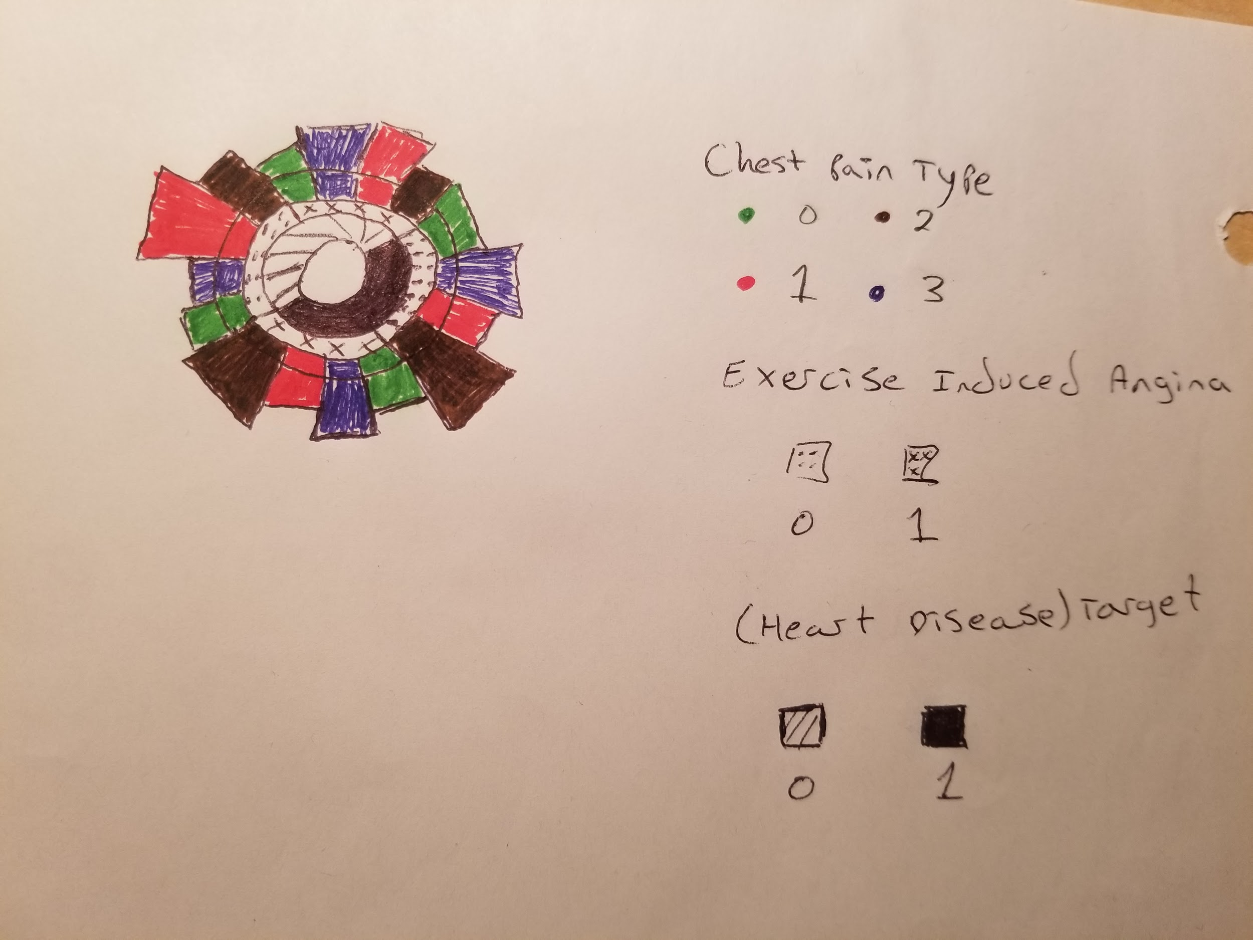
Initial Sketches
Shows warning signs for a heart attack for each chest pain type
Color (Chest Pain Type)
Dots or x’s (Exercise Induced Angina)
Hatched or filled (Target - Heart Disease)
Length (Max. Heart Rate)

Slide 13
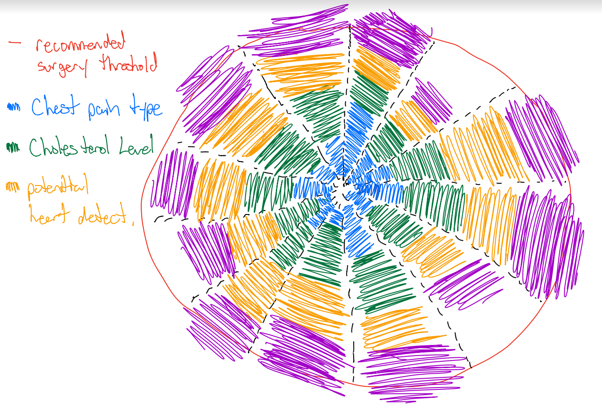
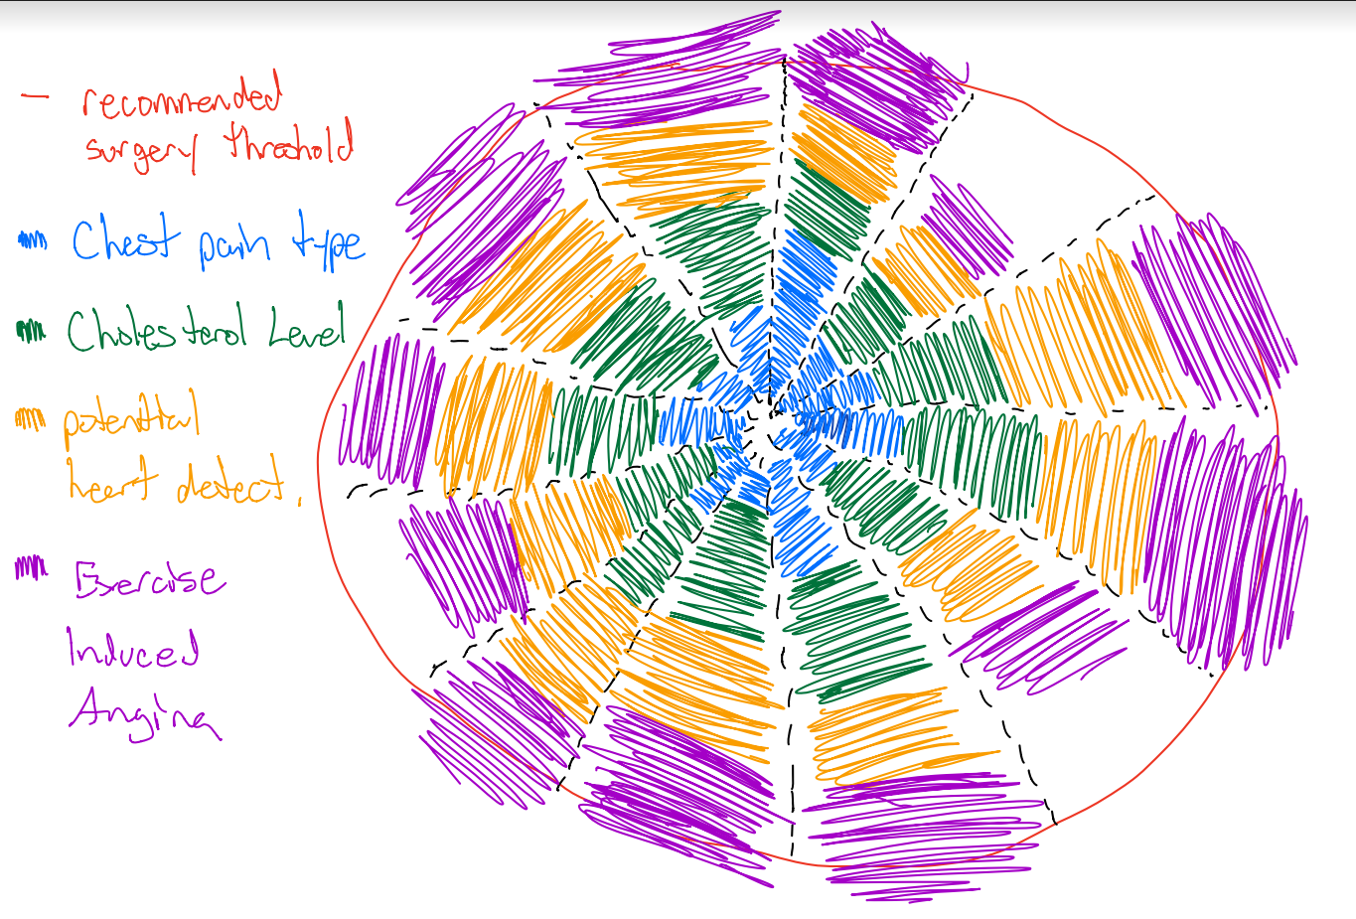
Initial Sketches
Determines if potential surgery is needed by important correlated weights crossing the threshold
Important data dimensions are
Chest pain type
Cholesterol level
Potential Heart Defects
Exercise Induced Angina

Slide 14
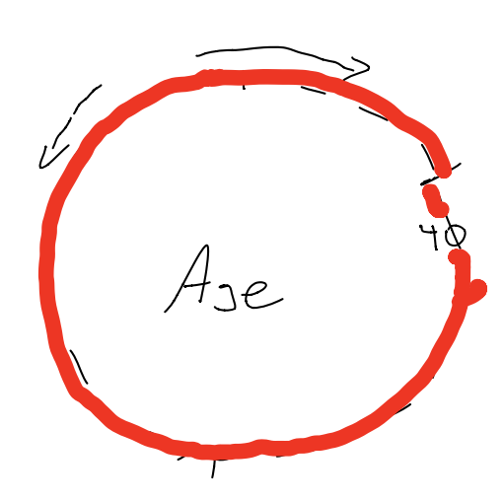
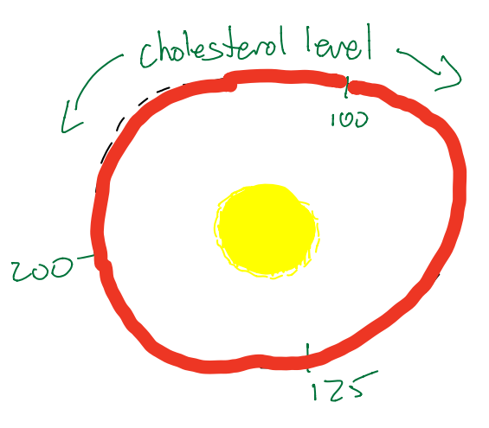
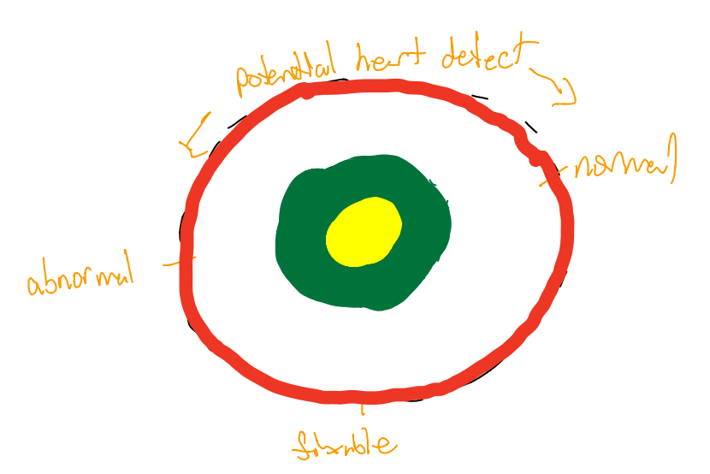
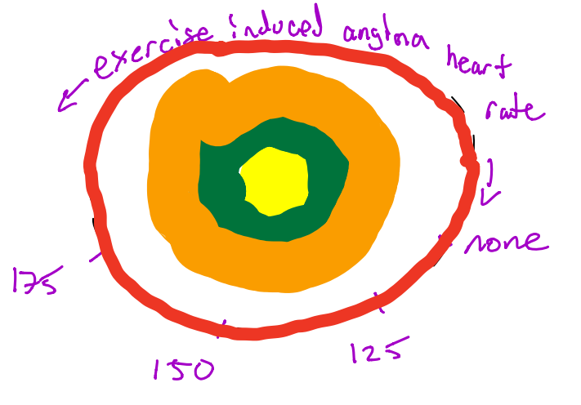
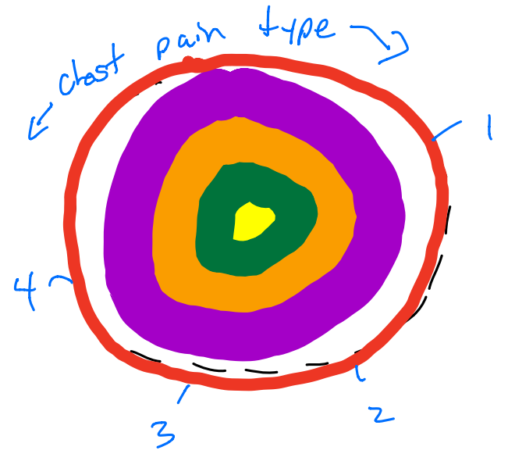
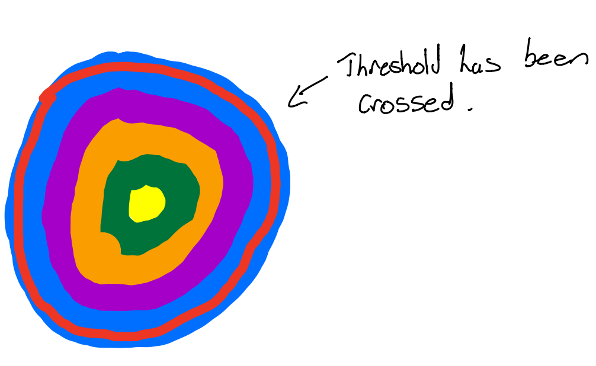
Initial Sketches

Slide 15
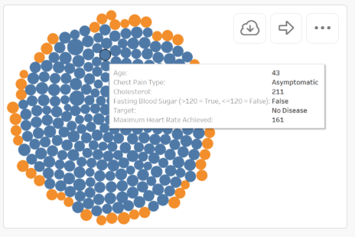
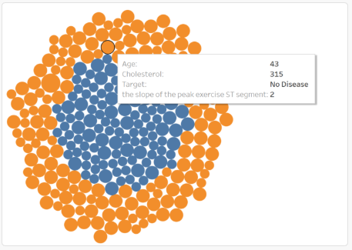
Design Explorations
Original Prototype Solutions
Attempting to discover a particular threshold of heart disease vs no disease.
Problems incurred
Difficult to determine correlation between what dimensions are contributing to heart disease or not
Doesn’t present much opportunity for analysis as new data dimensions simply change threshold colour as opposed.
The area of the packed bubbles creates a cleaner visualization but at a cost of information

Slide 16
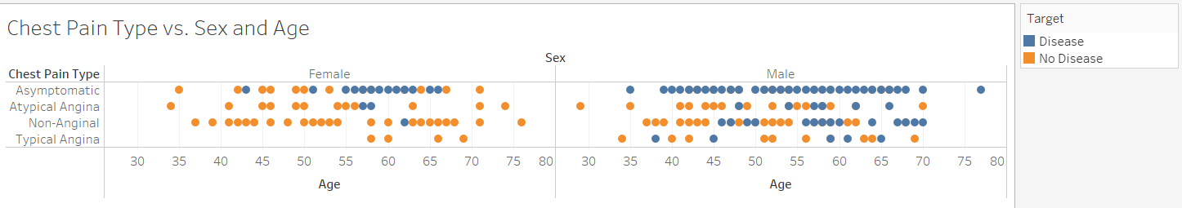
Design Exploration : Essential Nominal Variables
Chest Pain Type
Chest pain types have no order and as a result any position on a scatterplot wouldn’t convey proper information. We can easily see the amount of disease vs non disease from the amount of colour. However, for the males that it is difficult to tell whether or not Atypical Angina, or Non-Anginal chest pain results is a higher probability of heart disease versus not having it

Slide 17
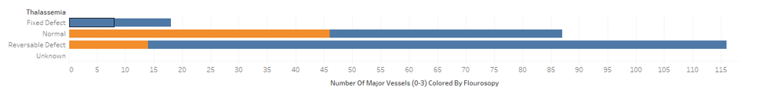
Design Explorations : Essential Nominal Variables
INITIAL SHIFT TOWARDS PACKED BAR GRAPHS
Packed Bar Graphs promoted a more visual discovery in terms of thalassemia in viewing whether or not disease was present
However the position doesn’t convey much information, and additional data dimensions cluttered the visualization

Slide 18
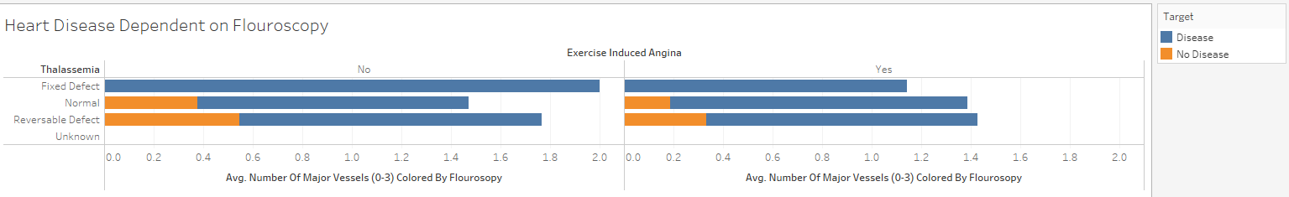
Design Explorations: Essential Nominal Variables
Another issue was the fact that our heart disease threshold would change depending on the the data inputs. For example the addition of exercise induced angina as a binary variable breaks this into two graphs. And it’s impossible to discover visual trends as the data was simply too general at this point. Expected values needed to be modified as the visualization was built

Slide 19
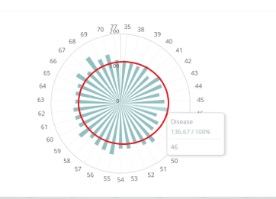
Design Explorations: Deciding on Polar Charts
The polar chart allows a user to pick which blood pressure they are at while being able to visualize what the expected value for that particular variable would be.
For example we see the average blood pressure of a 46 year old is with heart disease is 136.67

Slide 20
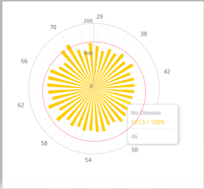
Design Explorations: Deciding on Polar Charts
When comparing the expected blood pressure for a 46 year year old with no disease we see that they are below the expected threshold currently, so we continue

Slide 21
Design Explorations: Deciding on Polar Charts
When comparing the expected blood pressure for a 46 year year old with no disease we see that they are below the expected threshold currently, so we continue

Slide 22
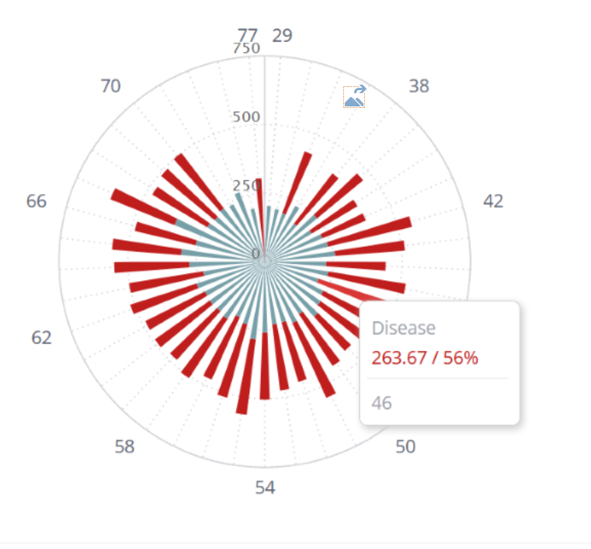
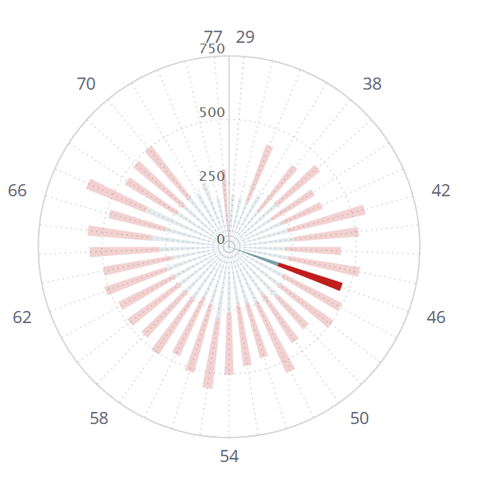
Design Explorations
A colour scheme was decided upon to reflect those of the Heart and Stroke foundation. It was also determined to eliminate the threshold radius.
A user would enter their criteria and the radial graph could change the hue of all other selections to focus on user’s selection.
Here we see age 46 was selected and the other hues dimmed.

Slide 23
Design Challenges
The Radial Heart Disease Threshold
The threshold was a difficult design decision. Originally we had a radius that was intended to indicate whether or not a patient was likely to have heart disease. However this radius was quite visually misleading.
For example there was an instance where the 50 year old patient group with an average resting blood pressure would likely indicate heart disease. However crossing a threshold visually indicates that if you’re past a line then you would

Slide 24
Design Challenges
The Radial Heart Disease Threshold
The threshold was a difficult design decision. Originally we had a radius that was intended to indicate whether or not a patient was likely to have heart disease. However this radius was quite visually misleading.
For example there was an instance where the 50 year old patient group with an average resting blood pressure would likely indicate heart disease. However crossing a threshold visually indicates that if you’re past a line then you would

Slide 25
Design Challenges
Software Limitations
Visualizations were attempted on
D3, Microsoft Power BL, Tableau, Sisense
It was difficult to transition from low level prototype to high fidelity visualizations while learning multiple forms of software. Ultimately sacrifices had to be made. Eventually we settled on Sisense as the software to be used for the visualizations which came with it’s own set of challenges

Slide 26
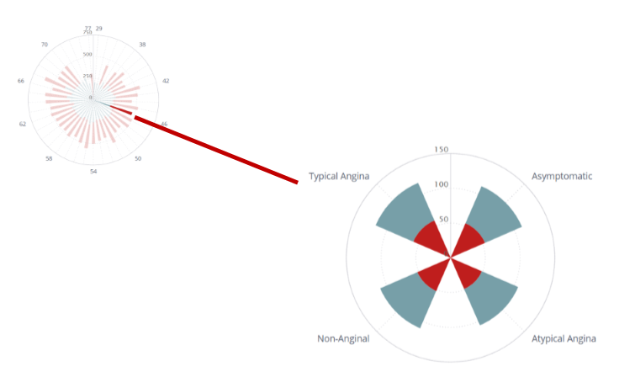


Visualization

Slide 27
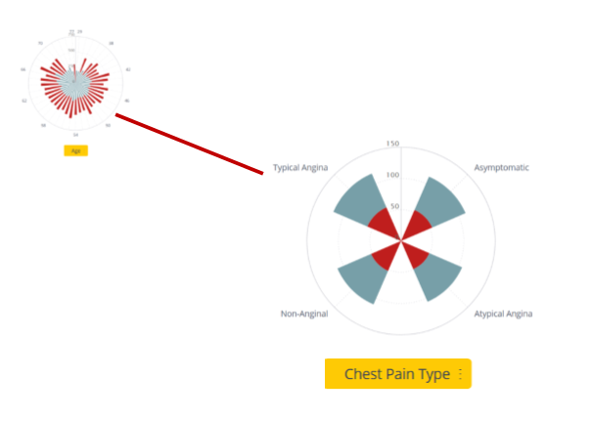
Visualization
Once a user selected their particular age the visualization would zoom out revealing new choice for the user to select from.
In this case it presents the user with which chest pain type they feel they have.

Slide 28
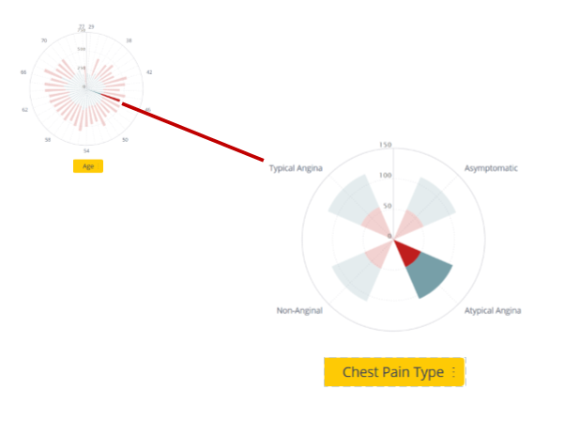
Visualization
Once a user selected their particular age the visualization would zoom out revealing new choice for the user to select from.
In this case it presents the user with which chest pain type they feel they have.

Slide 29
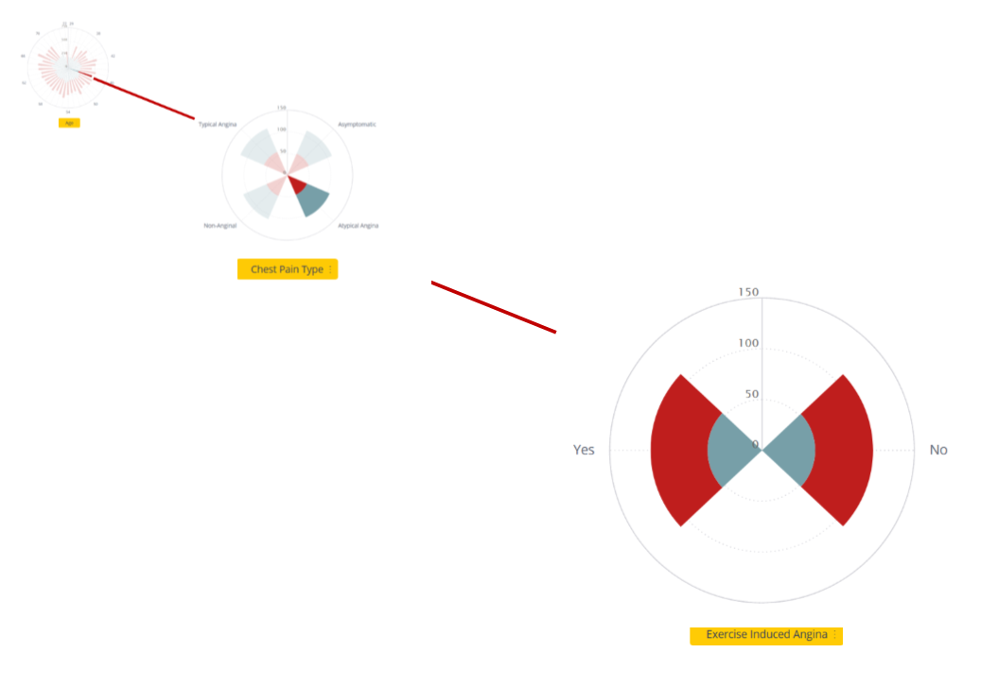
Visualization
Transitioning to Exercise Induced Angina

Slide 30
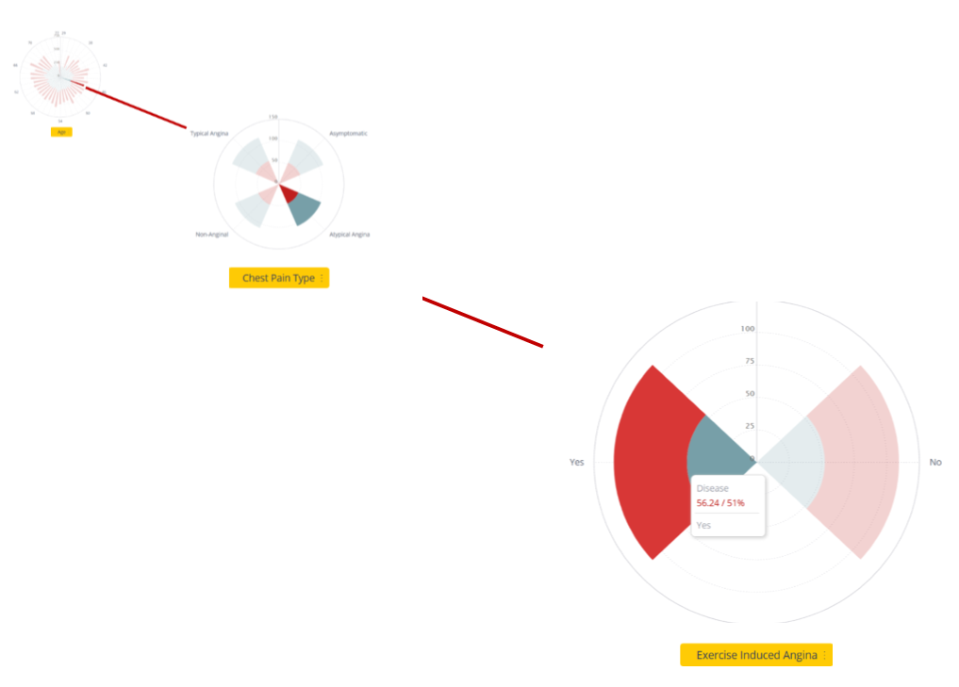
Visualization
Transitioning to Exercise Induced Angina

Slide 31
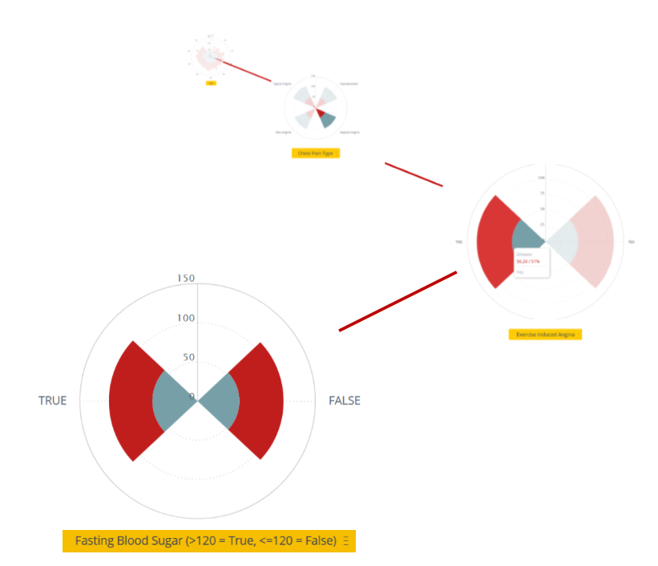
Visualization
Transitioning to Fasting Blood Sugar Results

Slide 32
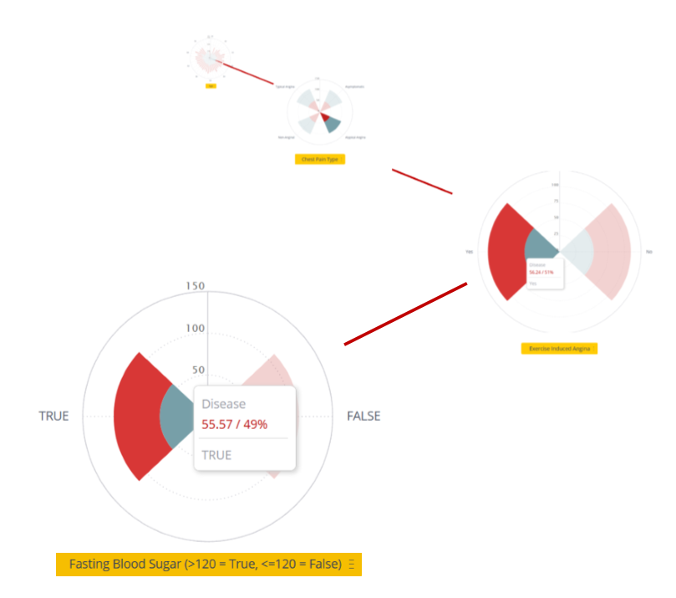
Visualization
Transitioning to Fasting Blood Sugar Results

Slide 33
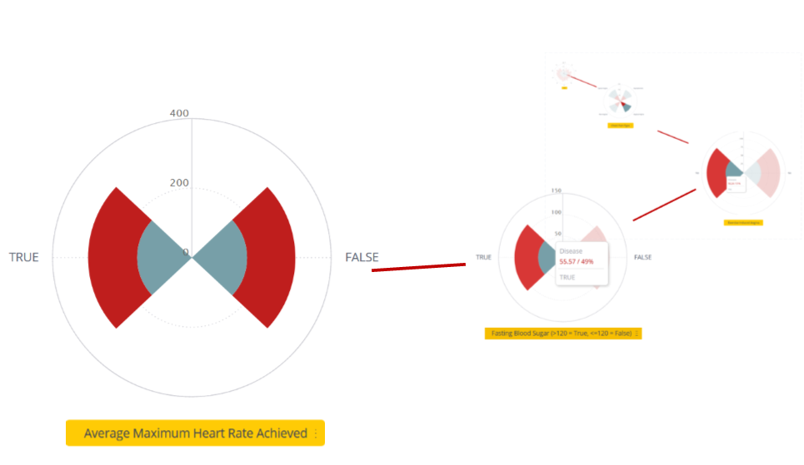
Visualization
Transitioning to Average Maximum Heart Rate

Slide 34
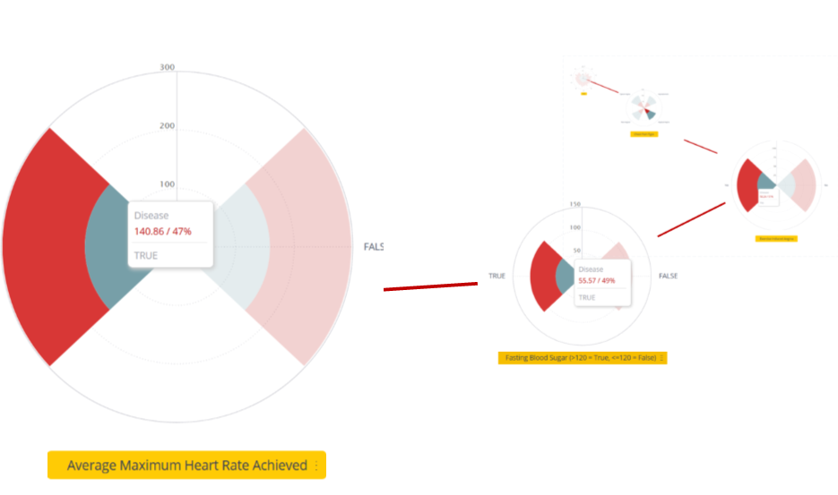
Visualization
Transitioning to Average Maximum Heart Rate

Slide 35
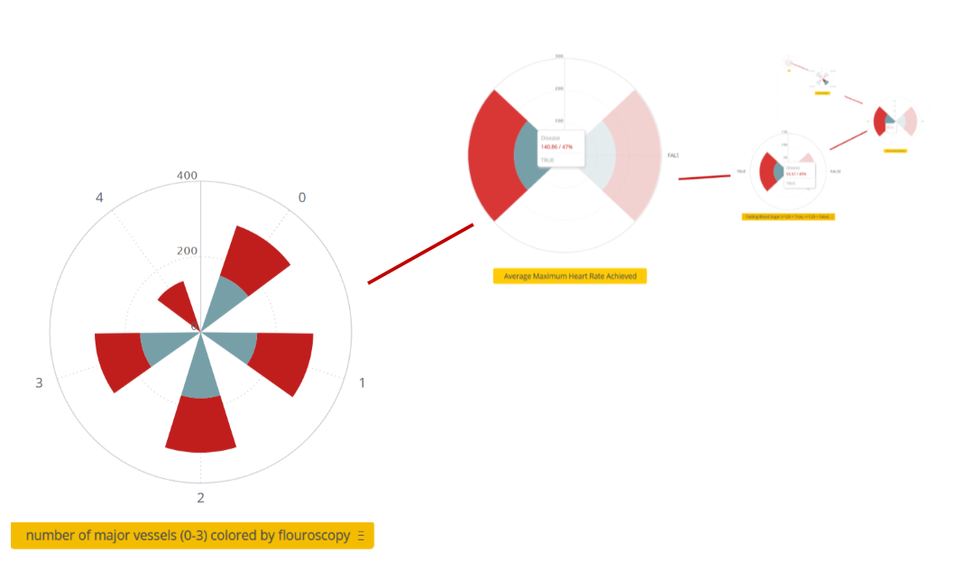
Visualization
Transitioning to Number of Major Heart vessels coloured by Fluoroscopy

Slide 36
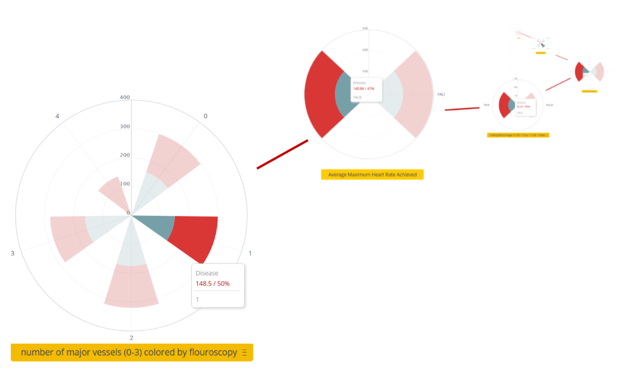
Visualization
Transitioning to Number of Major Heart vessels coloured by Fluoroscopy

Slide 37
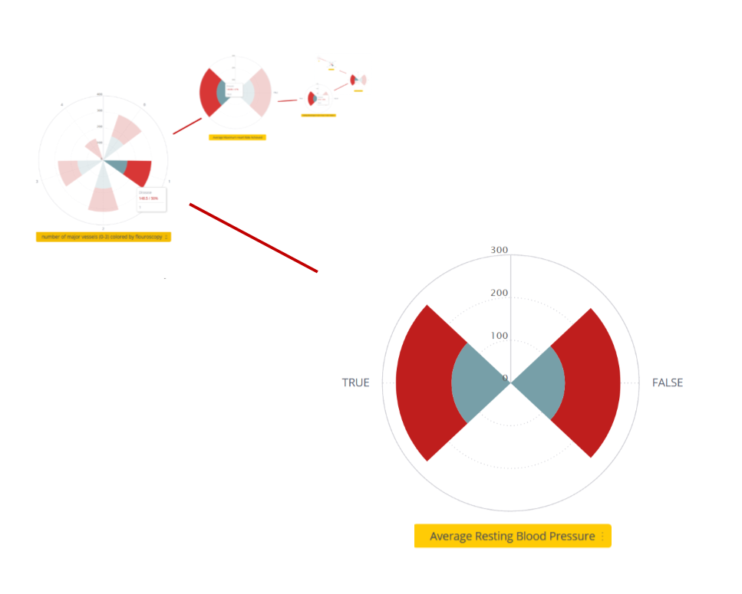
Visualization
Transitioning to Average Resting Blood Pressure

Slide 38
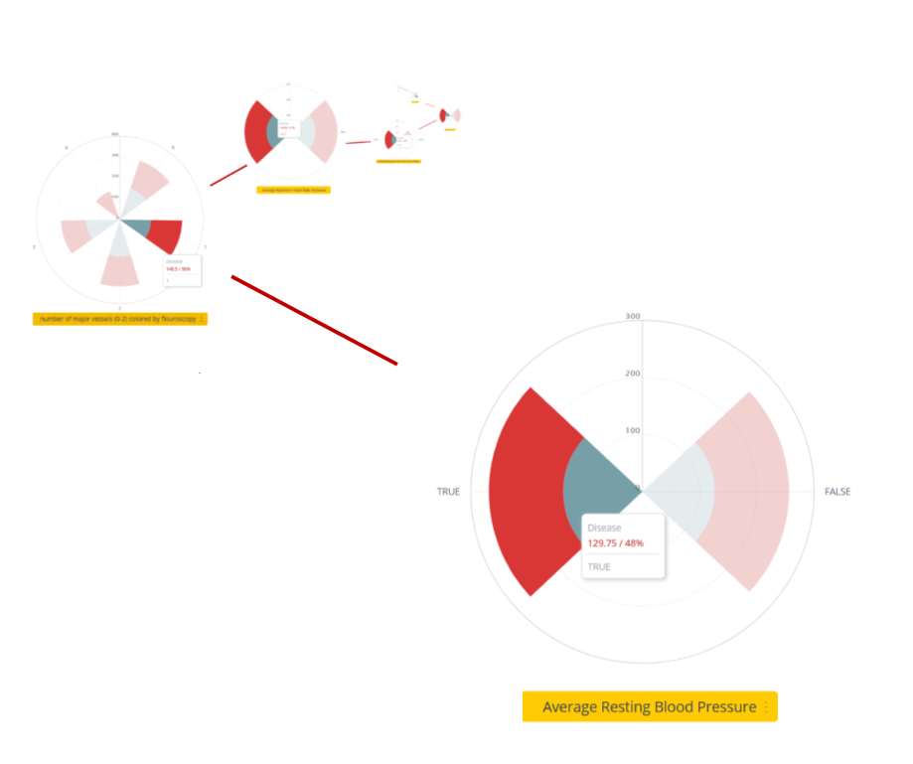
Visualization
Transitioning to Average Resting Blood Pressure

Slide 39
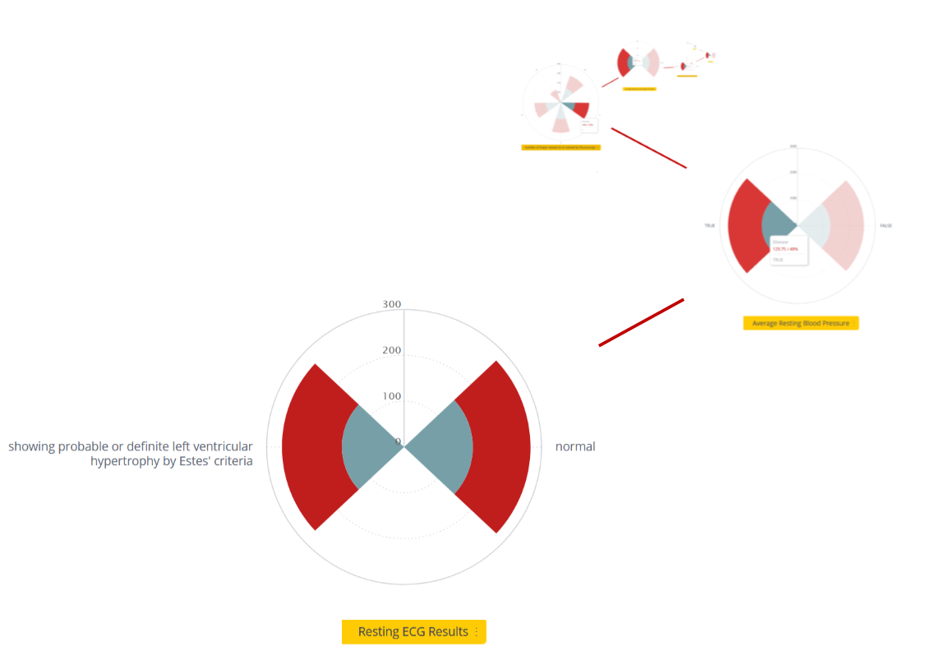
Visualization
Transitioning to ECG Results

Slide 40
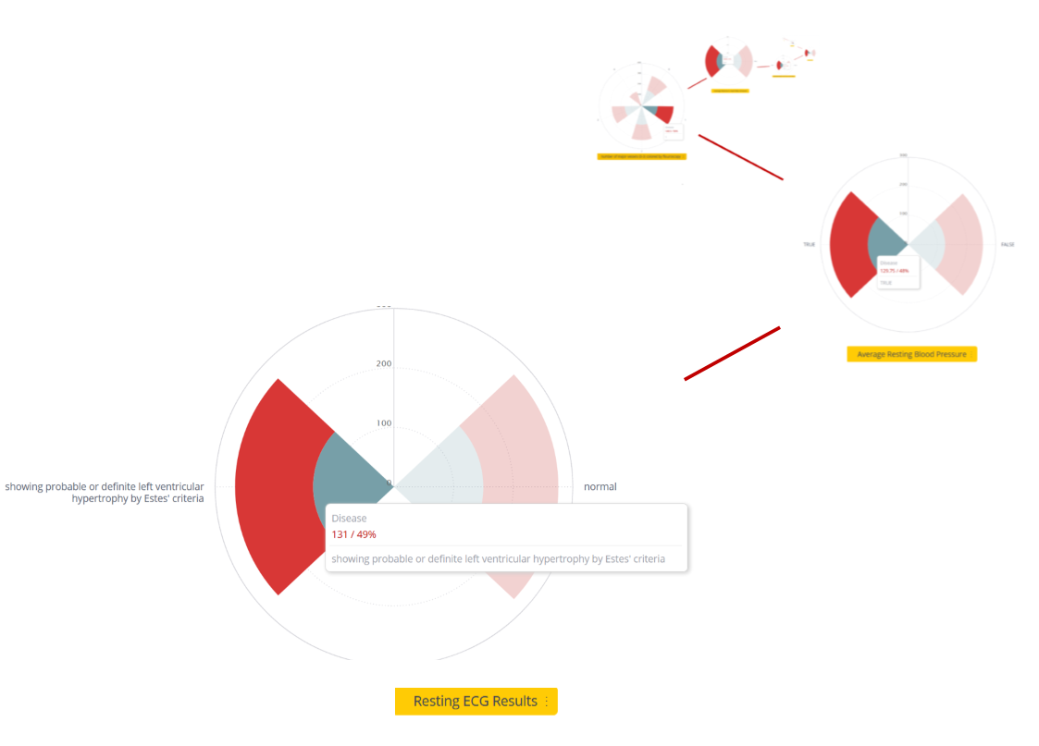
Visualization
Transitioning to ECG Results

Slide 41
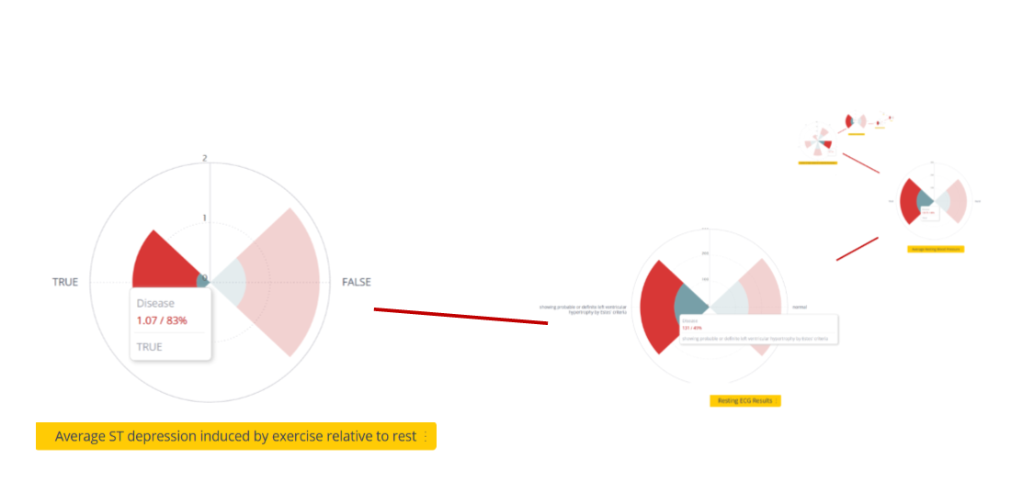
Visualization
Transitioning to average ST depression induced by exercise relative to rest

Slide 42
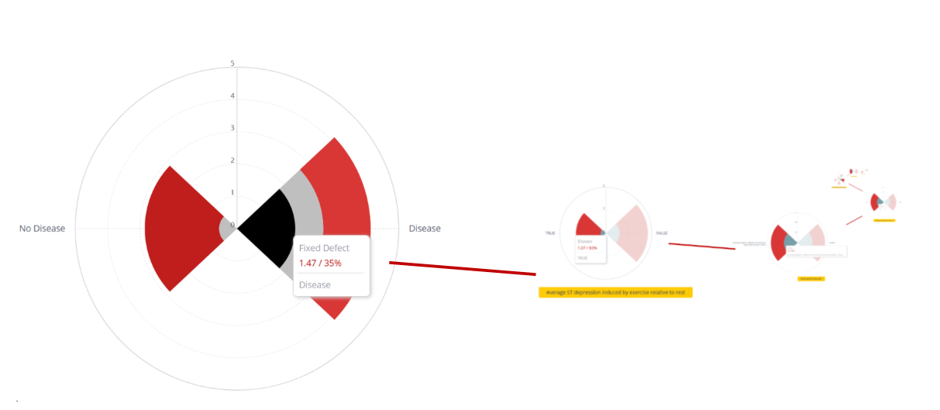

Visualization
Transitioning to thalassemia

Slide 43
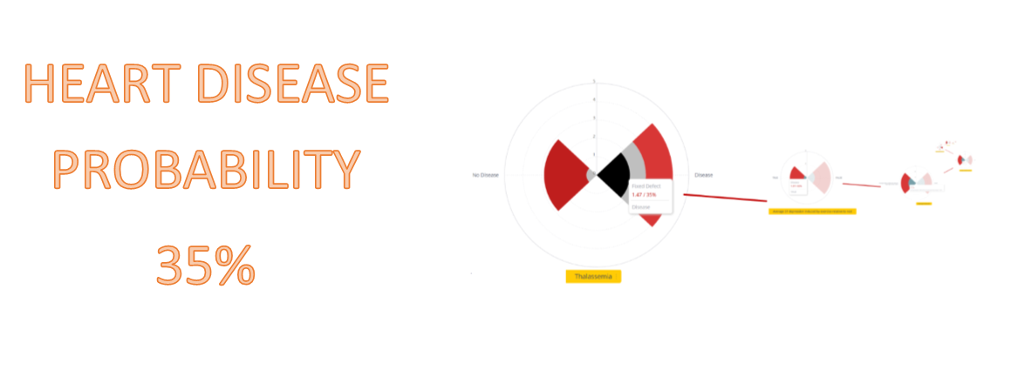
Visualization

Slide 44
Visualization Critique
Overall we felt like this was a weak visualization as it doesn’t present much information once you enter all of the factors in.

Slide 45
Visualization Critique
Possible Ways to Improve?
Perhaps a different visual as opposed to radial bar charts. Initially it was determined that the visualization could have a radial threshold that would indicate whether or not a patient had heart disease or not. However implementing the threshold on the data proved to be cumbersome as it appeared that no matter what you did you had a 50% chance of getting heart disease. The radial line didn’t add much.

Slide 46
Visualization Critique
Visualization Critique
Possible Ways to Improve?
The visualization itself was imagined as an interactive piece that would be built based upon user decisions.
This meant that the visualization would initially be empty and would provide no information until all the questions were answered. Even then the answer could come straight from a database, and there was no real visual discovery

Slide 47
Visualization Critique
Visualization Critique
Possible Ways to Improve?
Putting all of the radial graphs on the page at once
Since all of the graphs initially had a 50% ratio of having or not having disease it was determined that placing them all on the page at the same time wasn’t providing much of an answer either.

Slide 48
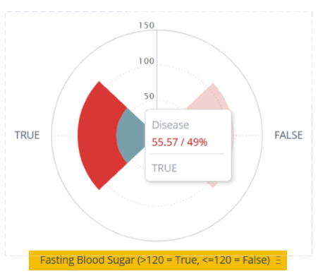
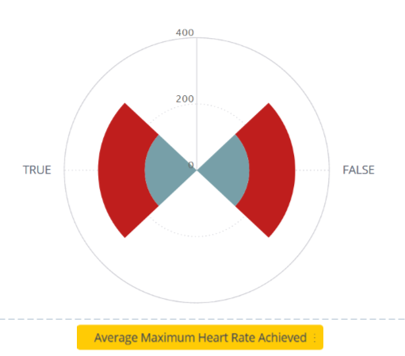
Visualization Critique
Visualization Critique
Possible Ways to Improve?
The values on the exterior of the radial charts were inconsistent based upon the which question was being asked of the user.
As a result the user could be confused as they would need to be constantly referring to the title of the particular chart

Slide 49
Research Findings
Informal Study conducted with
Dr. Nathan Plaa - Radiologist @ Vancouver General Hospital
Andrew Moro - CT technician @ Vancouver General Hospital
Maxim Kinakin - Nuclear Engineer @ Triumf Particle Accelerator
Samantha Gavrilko - Student @ Camosun College

Slide 50
Research Findings
Did we answer the question?
Can visualizations reduce the technical expertise needed in order to effectively diagnose heart disease?

Slide 51
Research Findings
Can visualizations reduce the technical expertise needed in order to effectively diagnose heart disease? NO
We were limited in our data cases , 303, and as a result the sample size was too small in order to effectively convey information

Slide 52
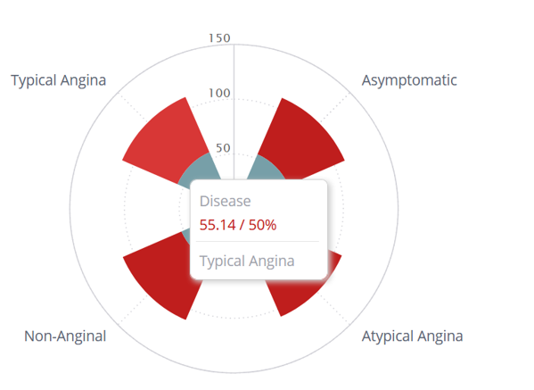
Research Findings
Did not reduce the technical expertise needed
For example here is a sample visual of chest pain type for the 55 year old age range with a chance of heart disease

Slide 53
Research Findings
Did not reduce the technical expertise needed
We can see you have a 50% chance of having heart disease if you’re roughy 55 years old and are experiencing typical angina chest pain symptoms.

Slide 54
Research Findings
Did not reduce the technical expertise needed
Not much emerging data when the chance is 50%

Slide 55
Research Findings
Did not reduce the technical expertise needed
Much of the data itself couldn’t be obtained without professional experience anyways.

Slide 56
Research Findings
Did not reduce the technical expertise needed
As a result of the small amount of data cases, it was recommended against using fuzzy set logic in order to make a decision.

Slide 57
Thanks for viewing our presentation

